Slide 1

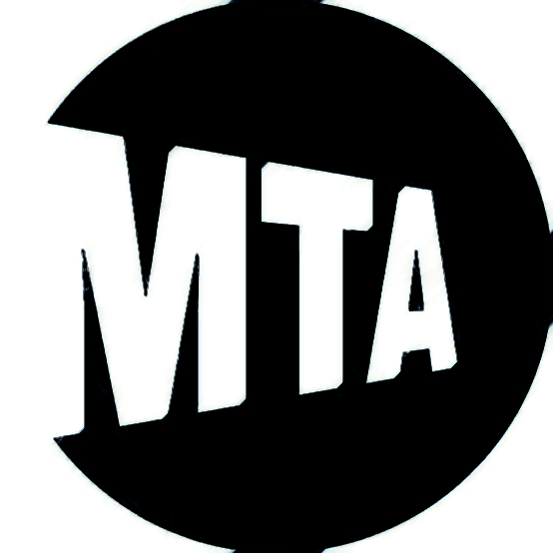

Daily Ridership
Digital Egypt Pioneers Initiative - DEPI
project

Slide 2
Member
Omar Muhammed
hani
Nada Rasmy muhammed
Hend abdelnasser
Bassant ali
Rahma muhammed muhammed
Mahmoud fathi

Slide 3
Contents
01
02
03
04
05
About MTA
Objectives
PROJECT OVERVIEW
06
Content plan
Analysis and visualization
RECOMMENDATIONS

Slide 4
01
MTA Transport

Slide 5
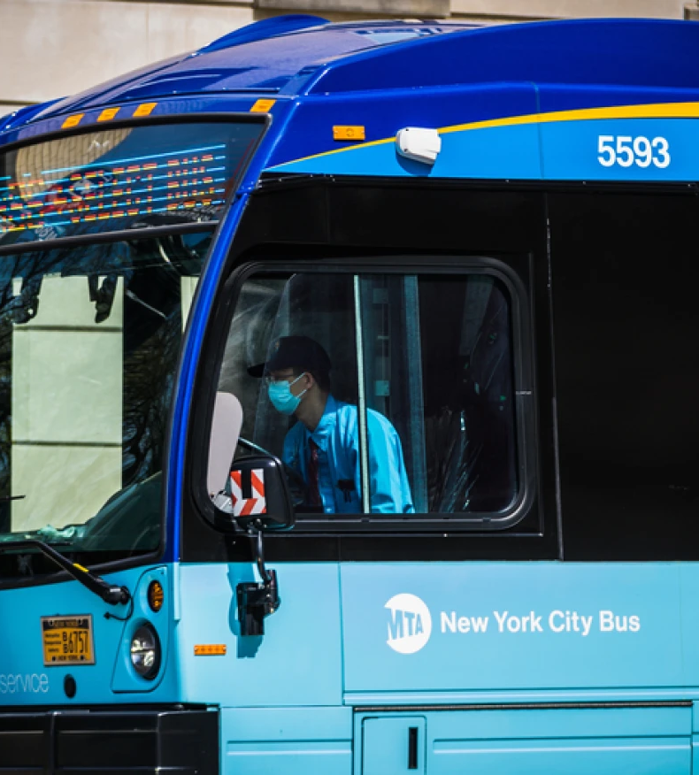
MTA Daily ridership
The Metropolitan Transportation Authority (MTA) is the biggest public transportation system in the U.S. It runs the subways, buses, and trains in New York City and nearby areas. Every day, millions of people use MTA services to travel.

Slide 6
02
Objectives

Slide 7
Objectives
Analyze ridership patterns across different MTA services.
Understand the impact of COVID-19 on public transportation.

Slide 8
03
PROJECT OVERVIEW

Slide 9




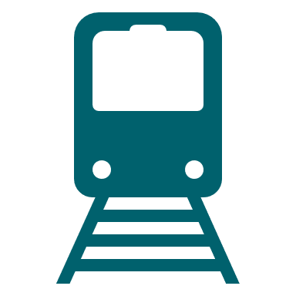


TYPES OF TRANSPORTATION
Staten Island Railway (SIR (
New York City Subway (NYCT)
New York City Buses
(NYCB)
rapid transit line on Staten Island
Bridges-Tunnels
Long Island Rail Road (LIRR)
Metro-North Railroad (MNR)
Access-A-Ride (AAR)
serving customers from Manhattan to the eastern tip of Suffolk County on Long Island.
connecting Manhattan with the Bronx, the Hudson Valley
The daily total scheduled Access-A-Ride
for people with disabilities
The daily total Bridges and Tunnels (B&T) traffic in NYC
FOR EVERY TRANSPORTATION: The daily total a percentage of total an equivalent day prior to the COVID-19 pandemic

Slide 10
Dataset Overview and Data Coverage:
Daily records starting from March,1 2020.
15 Column
Duration
4 years and 8 months
1706 days
Oct. 31 - 2024

Slide 11
754.24 K
6.4 bn
3/5/2020
Average of total daily ridership
Total Ridership
Max Ridership at day

Slide 12

Date
Ridership Counts
The day of the record.
Number of passengers for each transportation mode.
Pre-Pandemic Comparison
Percentage change compared to the 2019 baseline.

Slide 13
04
CONTENT PLAN

Slide 14
CONTENT PLAN
DATA CLEANING
Questions and key insights
Analysis and visualization
Preparing the data for analysis
Compare ridership between different transportation modes
Develop an interactive dashboard

Slide 15
Data cleaning
No missing values present ( blank or null cells)
Observations at Dataset
( Staten Island Railway) there values equals zero
this due to repairs at line of railway leading to stop for a period
2. At columns % there is a percents above 100% like 107%
Due to it indicates that the number of passengers exceeded the normal number on that day at pre pandemic 2019.

Slide 16

Questions and key insights
Descriptive Analysis – Ridership Trends
What is the overall trend of total MTA ridership from 2020 to 2024?
What was the average daily total ridership for each year?
Which date had the highest total ridership since March 2020?
Descriptive Analysis – Usage Patterns
How do transportation ridership levels compare on seasons of each year?
How did MTA ridership change month by month after the start of COVID-19?
{statistically significant drop in ridership during major COVID outbreak months?}
Which transportations are affected by pandemic period { least & most } ?
And which recovered quickly ?

Slide 17
Questions and key insights
Inferential Analysis – Behavioral Differences
Is there a significant difference between weekday and weekend total ridership?
Has subway ridership recovered more quickly than bus or rail ridership post-COVID?

Slide 18
Data preparation
Duplicated the original dataset to create separate tables for clearer analysis.
Applied Unpivot transformation to convert wide-format data into a tidy structure.
Organized the data into three distinct categories:
Transportation – duplicated twice: once for ridership counts and once for recovery ratios.
Access – duplicated twice: once for counts and once for ratios.
Bridges – duplicated twice: once for counts and once for ratios.

Slide 19
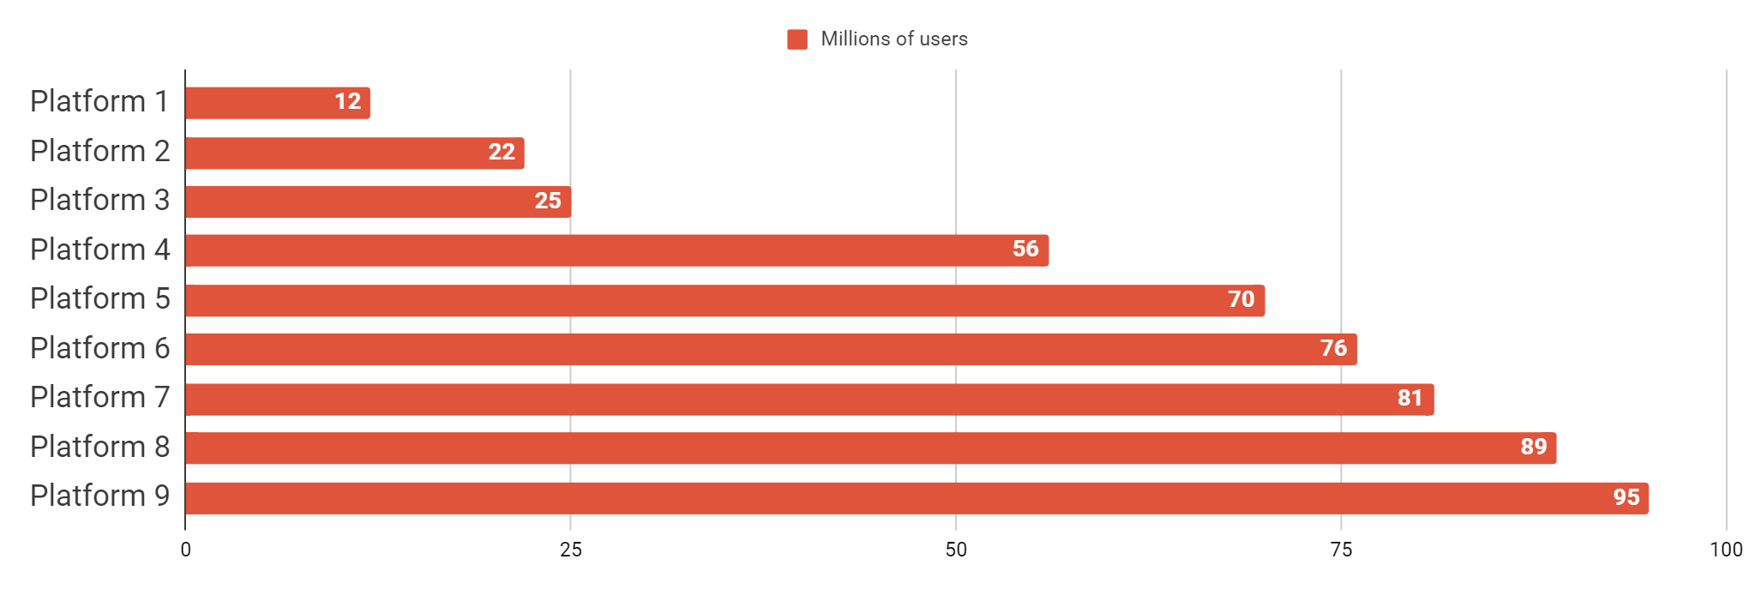
01
Analysis and visualization

Slide 20
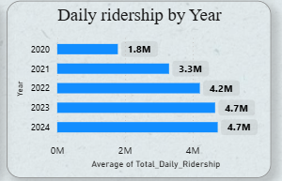
1
Steady Growth Post-2020:
In 2020, daily ridership was at its lowest, averaging 1.8M. This is likely due to the COVID-19 pandemic, which reduced public transportation usage.
There was a strong recovery in 2021, with ridership rising to 3.3M, showing a (double) increase compared to 2020.
2
Continued Recovery and Stabilization:
Ridership continued to increase in 2022 to 4.2M, marking a 1/3 increase from 2021.
In 2023 and 2024, ridership plateaued at 4.7M, suggesting the system has reached pre-pandemic or maximum capacity levels.
3
Possible Saturation Point:
No further growth between 2023 and 2024 may indicate the system has hit a saturation point, or that external factors (like infrastructure limits or rider behavior) have stabilized demand.

Slide 21
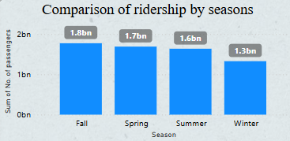
1
Fall Has the Highest Ridership:
The Fall season leads in ridership with 1.8 billion passengers, indicating it's the peak season for public transportation usage.
This could be due to a return to work and school routines after summer vacations.
2
Gradual Decline Through Seasons:
After Fall, there's a steady decrease:
Spring: 1.7B
Summer: 1.6B
Winter: 1.3B (the lowest)
This pattern shows a seasonal trend, where colder months (Winter) result in lower ridership, possibly due to weather conditions or holiday periods.

Slide 22
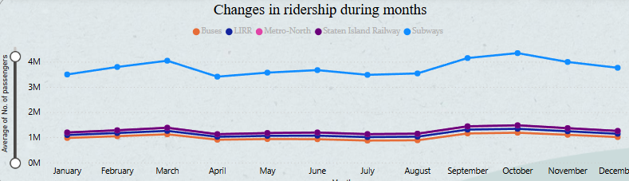
1
2
3
September and October are peak ridership months across all services — aligning with back-to-school/work seasons.
April and December are consistently low months, likely due to holidays (spring break, year-end vacations).
Subways dominate ridership, showing how critical they are to daily transportation.

Slide 23
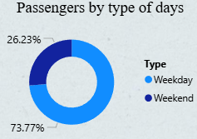
1
Most passengers travel on weekdays:
73.77% of the total passengers use transportation on weekdays.
This suggests that public transport is more heavily used during the regular working days (Monday to Friday), likely due to commuting to work, school, or university.
2
Fewer passengers travel on weekends:
Only 26.23% of the total passengers use transportation on weekends.
This lower percentage indicates reduced demand during weekends, possibly because people stay home or travel less for work-related reasons.

Slide 24
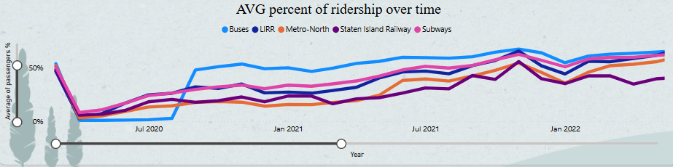
1
2
Sharp Drop in Early 2020:
All transportation types (buses, LIRR, Metro-North, Staten Island Railway, and subways) experienced a major drop in ridership around early 2020, likely due to the COVID-19 pandemic. Ridership dropped close to 0%.
Buses Recovered Faster:
Buses (blue line) showed a faster and higher recovery in ridership compared to other services. They consistently maintained the highest percentage of ridership over time

Slide 25
3
4
5
Post-2021 Trends:
From mid-2021 to early 2022, ridership percentages became more stable and slowly increased. Most modes were approaching or surpassing 50% of pre-pandemic levels, but not fully recovered
Subtle Fluctuations:
There are some ups and downs, possibly due to waves of COVID variants or seasonal changes, but the overall trend is upward.
Gradual Recovery for Rail Services:
LIRR (red), Metro-North (orange), and Subways (purple) had a slower recovery. The Staten Island Railway (pink) remained the lowest in ridership throughout the entire period

Slide 26
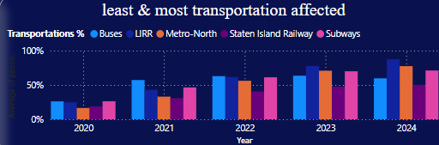
1
Overall Trend :
There's a gradual increase in the percentage of all transportation modes affected from 2020 to 2024.
Most Affected Mode:
Buses (Blue) consistently show the highest percentage affected, especially in 2024, reaching nearly or above 100%.Subways (Pink) also show a strong increase and are among the most affected in recent years.
2

Slide 27
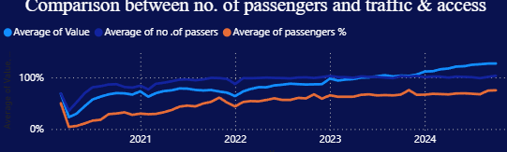
1
Sharp decline in early 2020: All metrics (traffic, number of passers, and passenger %) dropped significantly at the start, indicating the impact of the pandemic.
Gradual recovery: From mid-2020 onward, all values showed a steady recovery, though at different rates.
2

Slide 28
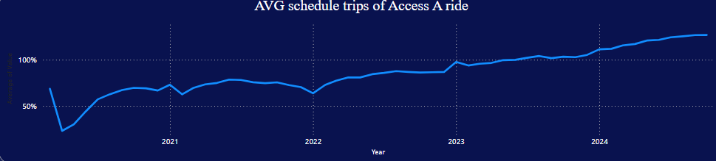
1
2
Sharp Decline in 2020:There was a steep drop in average scheduled Access-A-Ride trips around early 2020.This is likely due to the COVID-19 pandemic, as mentioned in the annotation, where demand dropped sharply.
Steady Recovery (2021–2022):After the initial drop, there's a gradual recovery from mid-2020 into 2021.The values stabilize around the 50%–75% range through 2021 and early 2022.

Slide 29
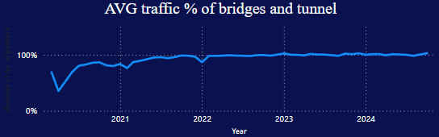
1
2
Sharp drop in traffic in 2020: There is a significant decrease in traffic at the beginning of the chart, reflecting the impact of the COVID-19 pandemic.
Quick recovery after the drop: Traffic levels rose quickly after the 2020 dip, approaching pre-pandemic levels.

Slide 30
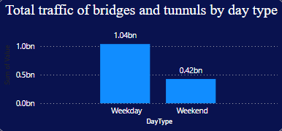
1
2
Weekday traffic more than double: The volume of traffic on weekdays is more than 2.4 times that of weekend traffic, highlighting a strong weekday commuting pattern.
Higher traffic on weekdays: Weekday traffic is significantly higher at 1.04 billion compared to 0.42 billion on weekends.

Slide 31
Conclusion
1
COVID-19 Impact: Ridership dropped sharply in 2020 due to the pandemic but showed a strong recovery from 2021 onward.
2
Post-Pandemic Stabilization: Ridership plateaued in 2023 and 2024, suggesting a new post-COVID baseline.
3
Seasonal Trends: Fall consistently shows the highest ridership, while Winter is the lowest across all years.
4
Subway Dominance: Subways remain the most-used mode of transport throughout the year, showing system reliance.
5
Monthly Peaks: Ridership peaks in September and October and drops in April and December.

Slide 32
06
RECOMMENDATIONS

Slide 33
1
Adjust Services Based on the New Post-COVID Baseline
Since ridership has stabilized in 2023–2024, align service levels with the current demand, rather than aiming to return to pre-COVID numbers.
Focus on service quality and reliability to retain and satisfy existing riders.
2
Seasonal Resource Planning
Allocate more staff, trains, and buses during Fall and early Autumn months, when ridership peaks.
Plan maintenance and cost-saving operations during Winter and April, when ridership drops.
3
Improve Pandemic Readiness
Develop crisis response strategies to minimize service disruption and passenger loss in case of future events like pandemics or natural disasters.
4
Promote Off-Peak Usage
Launch marketing campaigns, fare discounts, or flexible ticketing to encourage ridership during low-demand months (e.g., Winter, April, July).

Slide 34
THANK YOU

